Slide 1
CS5131 Project Presentation
Ashley Khoo and Daniel Toh
M21503
Note: this was done before we finalized stuff, so some results might be outdated.

Slide 2
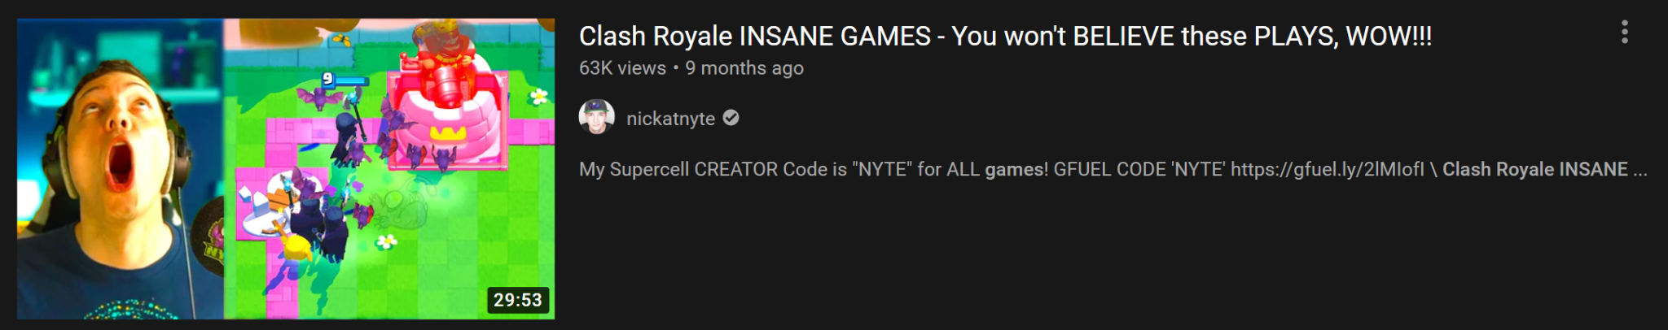
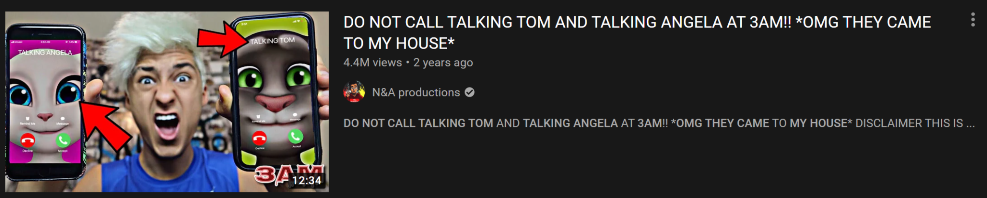
Introduction

Slide 3
Objective
To create a model that can accurately classify a youtube video as clickbait or not based only on its metadata (title, thumbnail, description, likes/dislikes/views)

Slide 4
Dataset
The dataset was obtained by scraping youtube videos based on their id.
We prepared two datasets:
Alpha dataset: labelled based on channel (9000+ videos)
Beta dataset: hand-labelled data (340 videos)
Further split into Beta0 (170 videos) and Beta1 (170 videos)
 | Alpha | Beta0 | Beta1
Non-clickbait | 5477 | 128 | 124
Clickbait | 4264 | 42 | 46

Slide 5
Model
For our model to work, we must consider what makes a video clickbait?
Thumbnail
Title

Slide 6
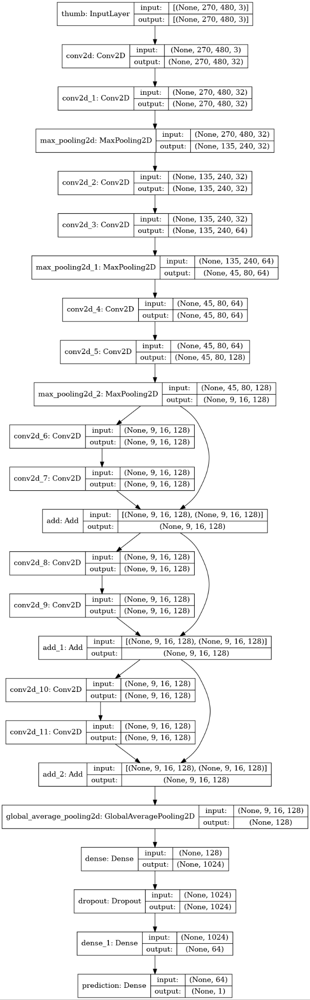
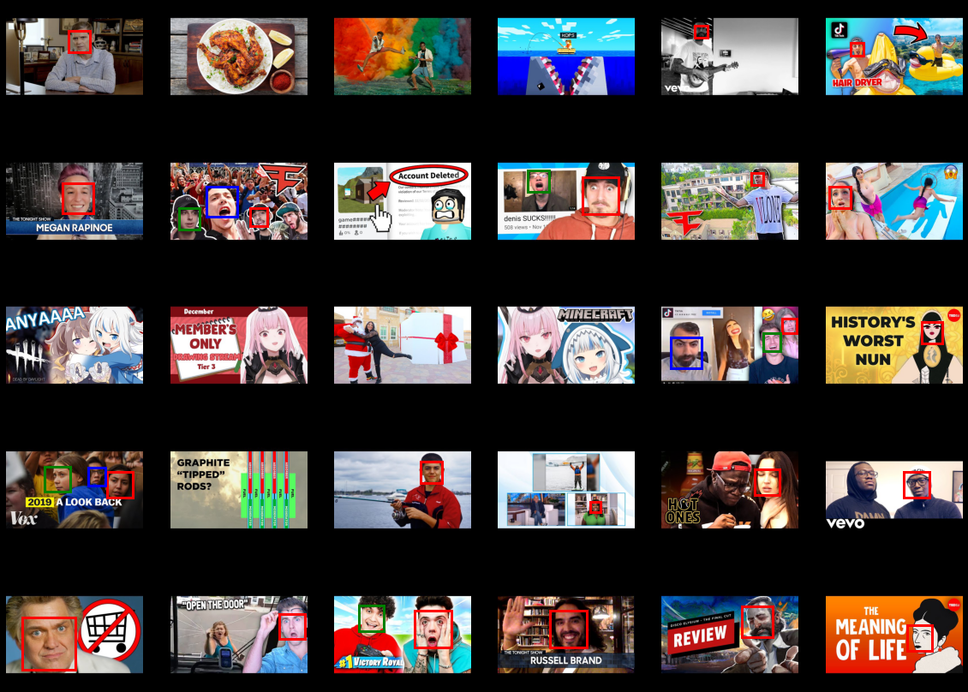
Thumbnail

Slide 7
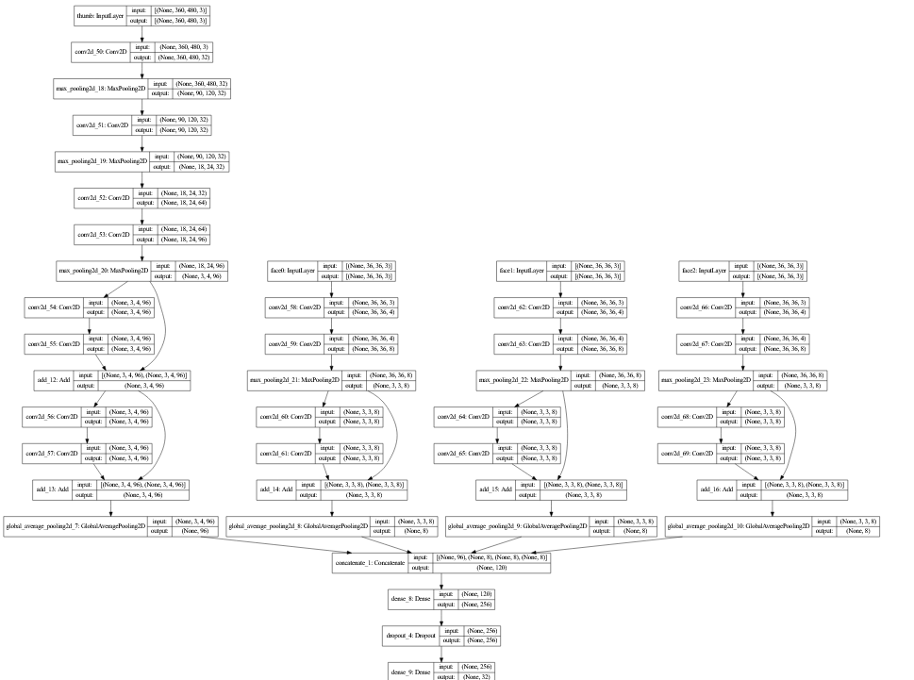


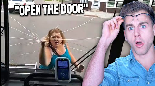

Slide 8
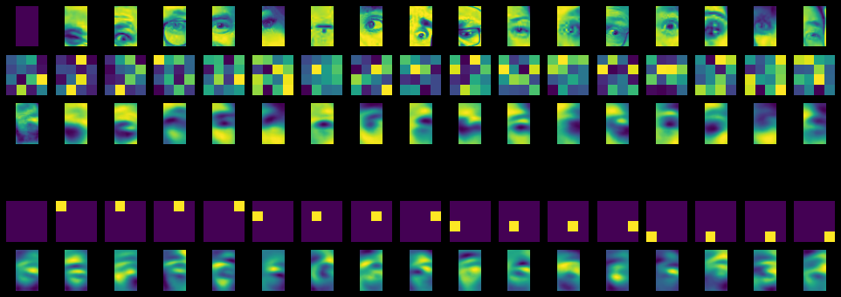
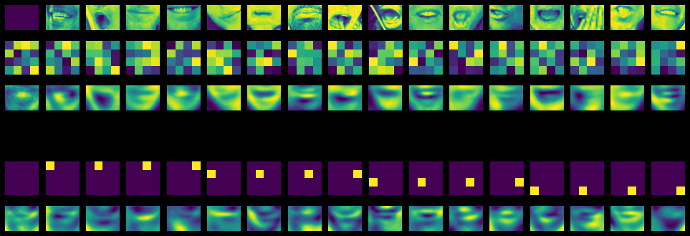
Autoencoder

Slide 9
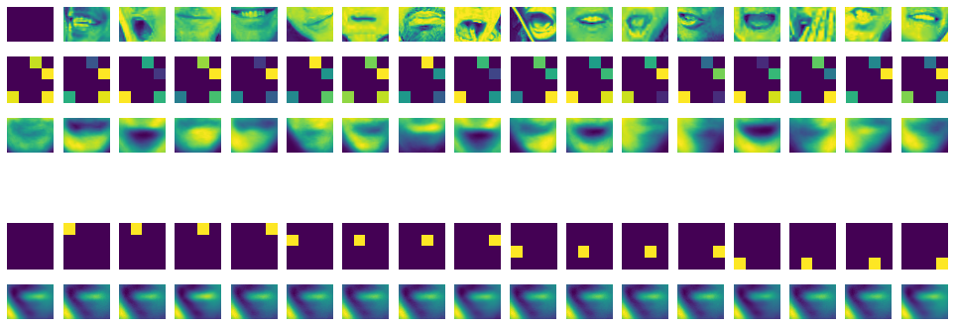

Slide 10
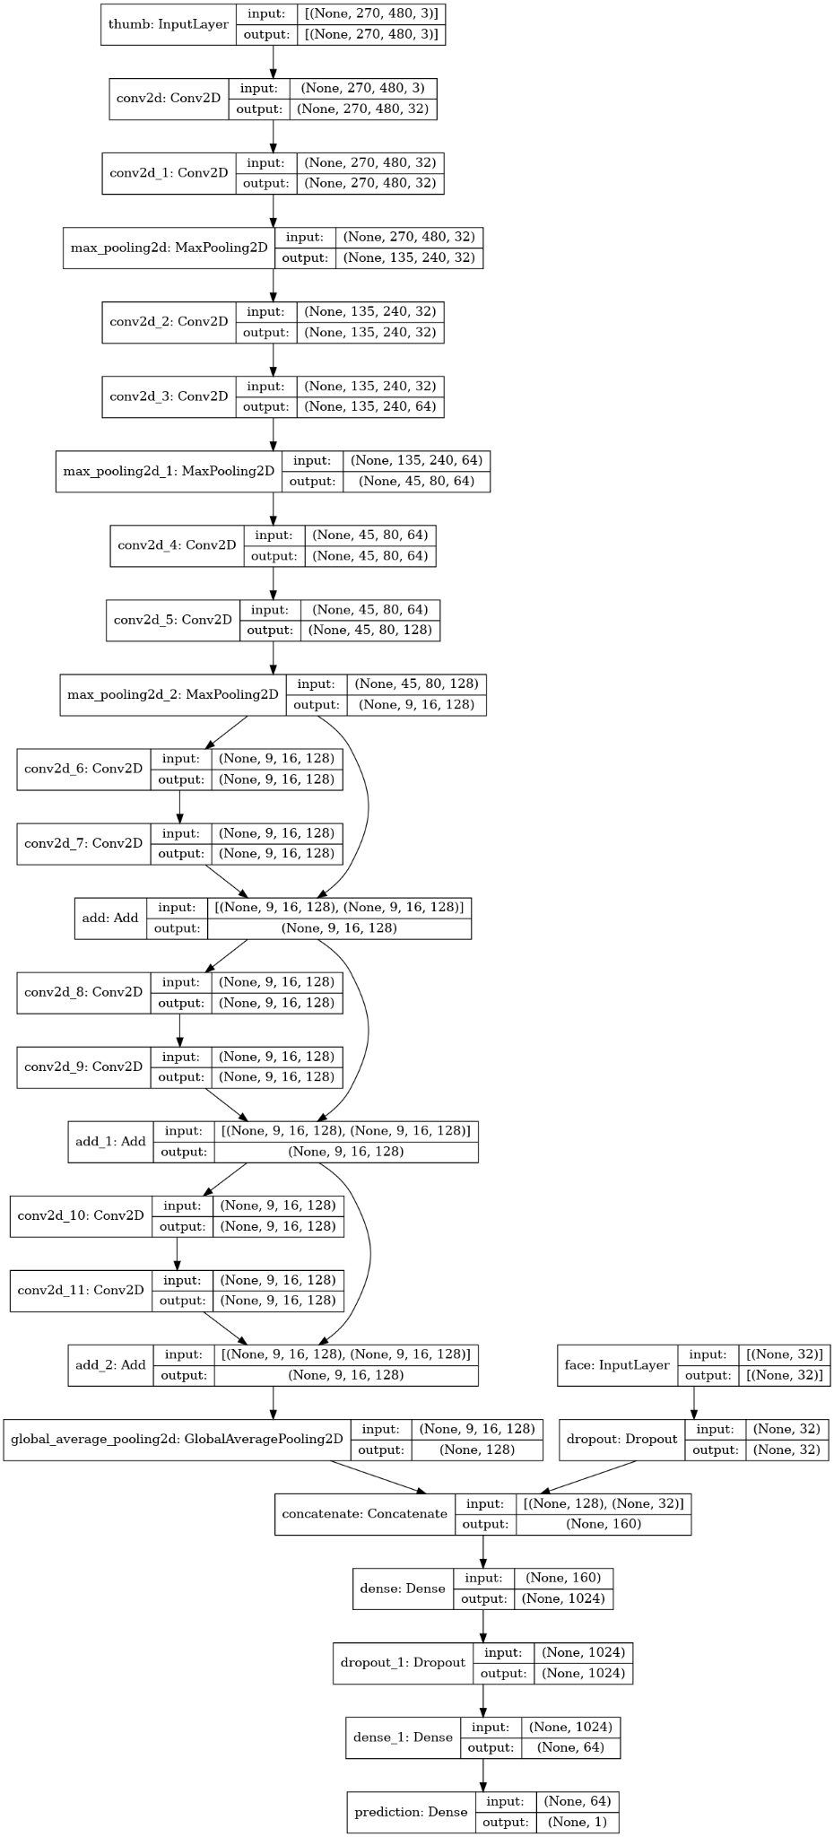

Slide 11
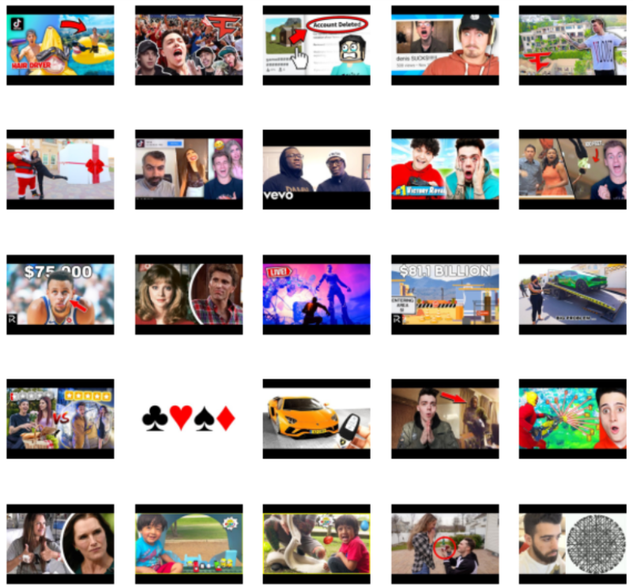
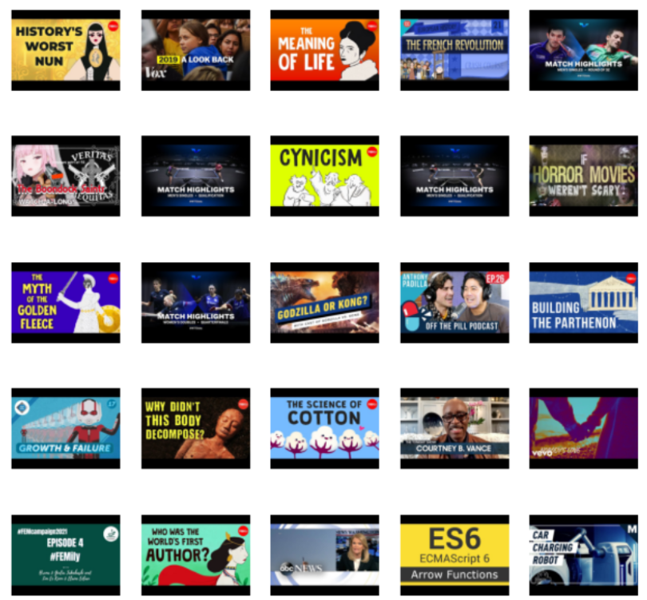
Clickbait (score > 0.9)
Not clickbait (score < 0.1)

Slide 12
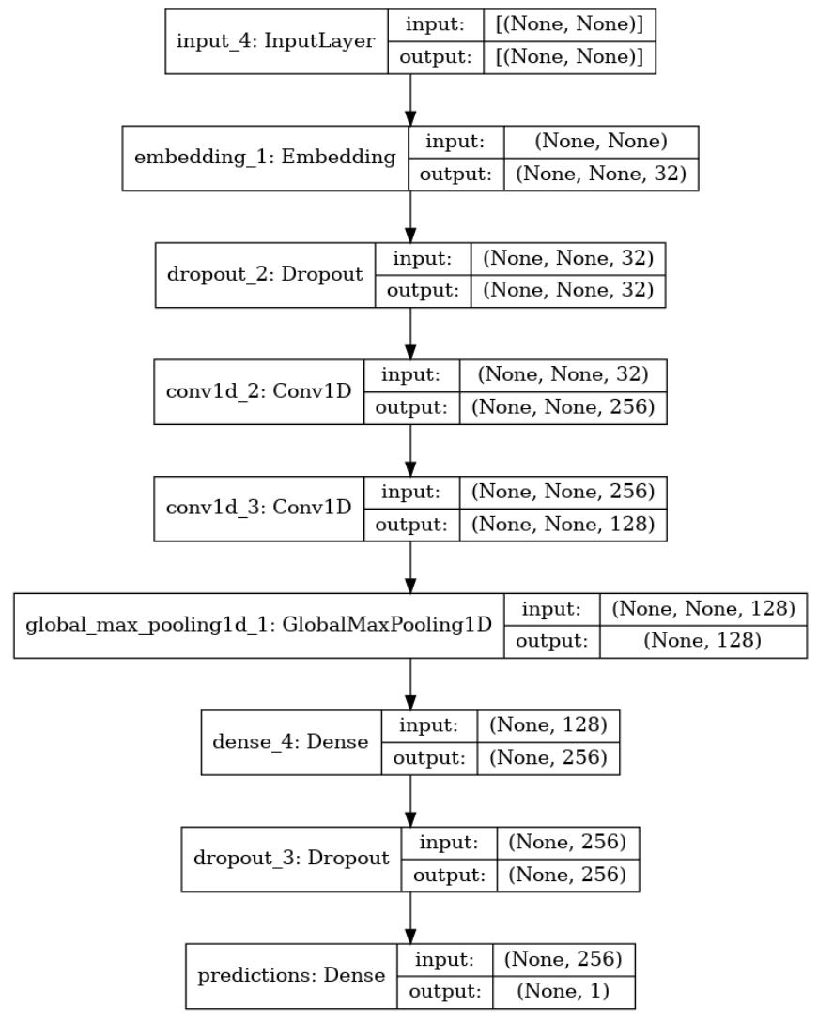
Title
Original title: Hunting The SECRET MEGALODON BOSS In Minecraft!
Processed title: hunt secret [&CAP] megalodon [&CAP] boss [&CAP] minecraft !
Preprocessing (mostly using nltk):
Removal of non-printable characters
TweetTokenizer
Marking of capitalized words and converting to lowercase
Removal of stop words
Lemmatization
TextVectorizer in keras
Embedding
Convolutional Neural Network
2x 1D convolution layers with dropout
Dense layer

Slide 13
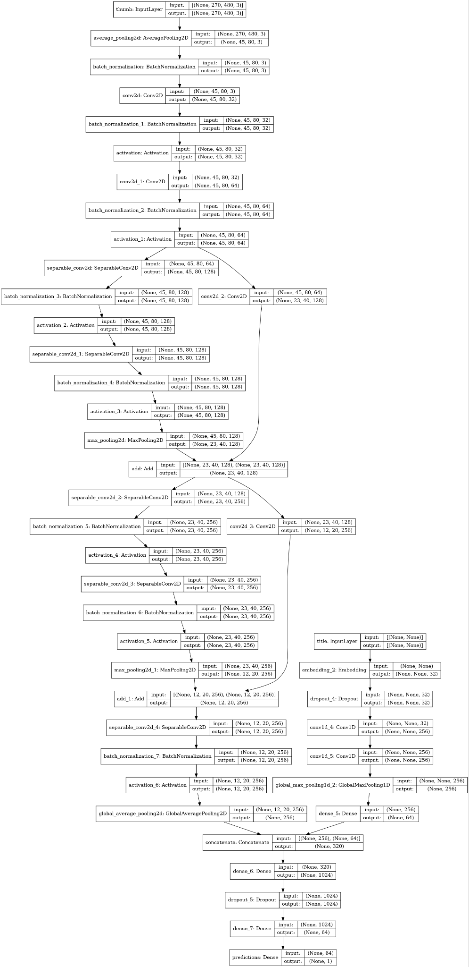
Model
We combine the two models to obtain our model for training.
Accuracy | 0.9338
Precision | 0.9597
Recall | 0.8905
F1 | 0.9210

Slide 14
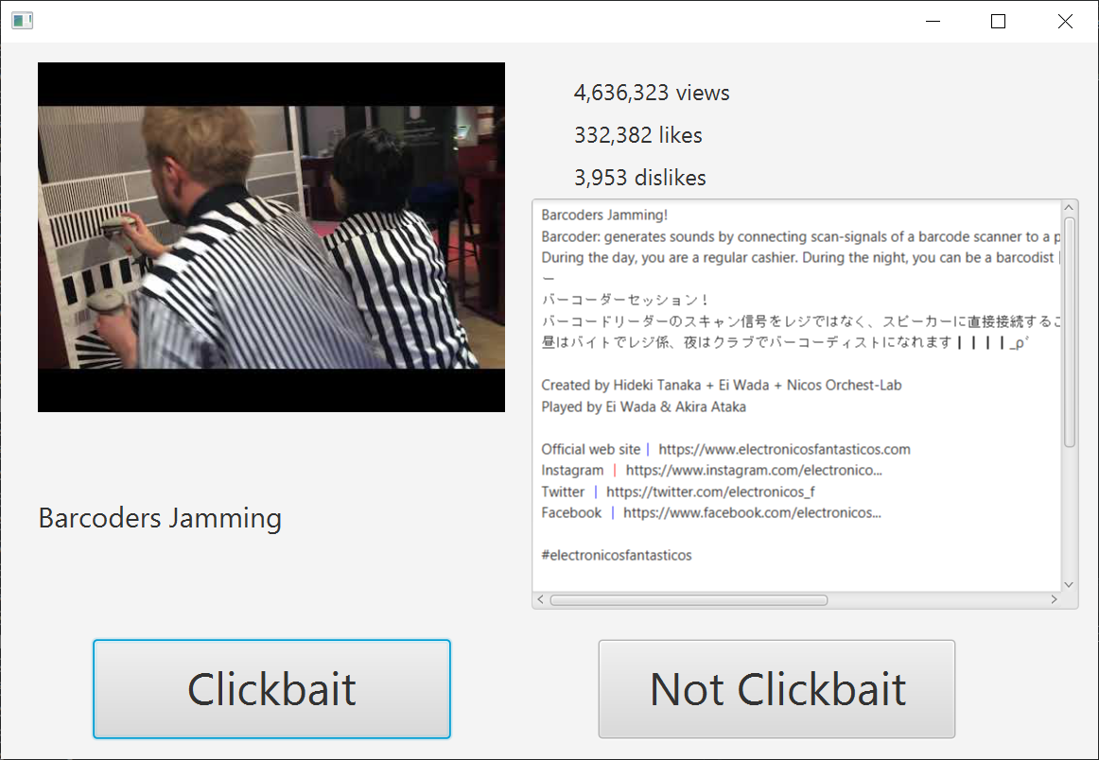
Extension
We ran our program on 170 hand labelled videos.
We also asked human volunteers to label the videos using a javafx application and we compared their f1 scores to that of our model.

Slide 15
Extension Results
Evaluator | F1 Score
Human 1 | 0.779
Human 2 | 0.767
Human 3 | 0.716
Human 4 | 0.689
Human 5 | 0.672
Our model | 0.641
Human 6 | 0.638
Human 7 | 0.557

Slide 16
GUI
Time constraints
Tkinter
Very basic input and output program
Displays verdict (clickbait / not clickbait) and the score

Slide 17
GUI Demo

Slide 18
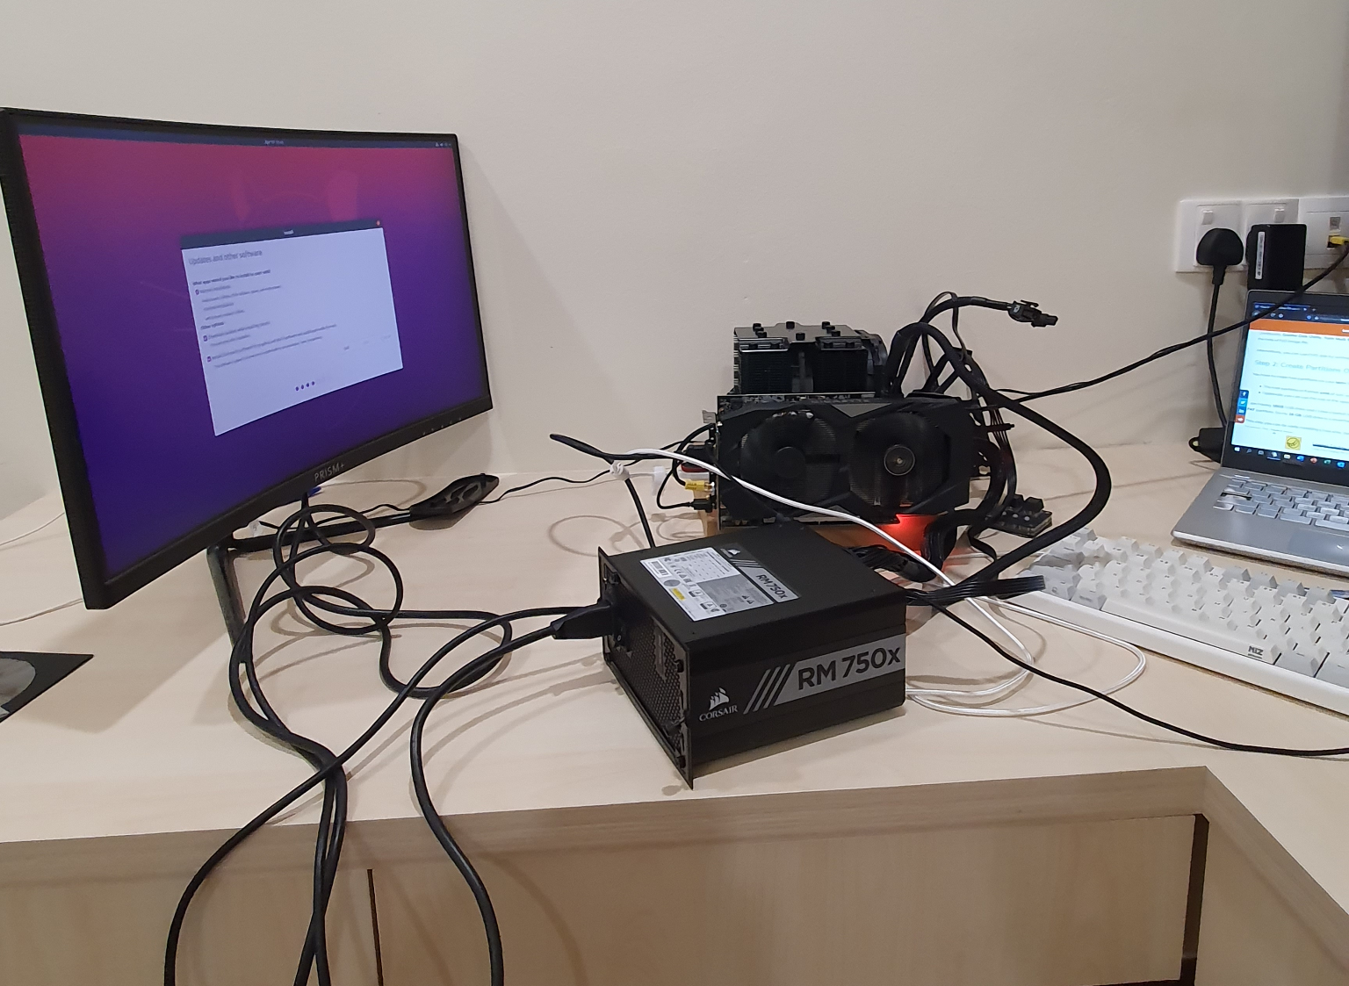
Limitations
Insufficient data
Videos based on channels not very accurate, different from hand-labelled
Validation vs test set for accuracy and f1 score difference
Clickbait video may not have both clickbait title and clickbait thumbnail.
Despite the objective description, being “clickbait” is still open to interpretation
Low accuracy across human volunteers
CNN takes very long to train

